Slide 1
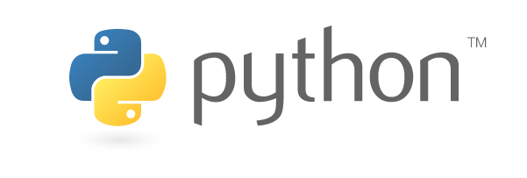
An introduction to machine learning with
Håkon Hapnes Strand Consultant in Insights & Data

Slide 2
Download Python 3.x from https://www.anaconda.com/download/

Slide 3
Agenda
0. The What, Why and How of Python
Python download and setup
Jupyter Notebook
Basic Python syntax
Core data science libraries
Machine learning case
Brief introduction to NLP

Slide 4
What?
Python is a general-purpose, interpreted programming language.
Developed by Dutch programmer Guido van Rossum and released in 1991.

Slide 5
Why?
Python is the 4th most popular programming language in the world (https://www.tiobe.com/tiobe-index/), the highest it’s ever been.
Python is open-source.
Python’s recent rise in popularity is largely due to the rise of data science and machine learning.
Python has more than 1000 packages more or less related to data science.
Python has a great community.
Python is easy and fun!

Slide 6
How?
We’ll try to cover that next…

Slide 7
Agenda
0. The What, Why and How of Python
Python download and setup
Jupyter Notebook
Basic Python syntax
Core data science libraries
Machine learning case
Brief introduction to NLP

Slide 8
The Anaconda distribution
Python distribution specifically aimed at data science.
~433 packages preinstalled (basically everything you need for ML)
Download Python 3.x from https://www.anaconda.com/download/
Anaconda includes the conda package manager.
conda cheat sheet: https://conda.io/docs/_downloads/conda-cheatsheet.pdf

Slide 9
Python 3 vs. 2
Python 3 is the future and present. Python 2 is legacy.
Check Python 3 compatibility at http://py3readiness.org/.
The main differences in Python 3:
Strings are unicode by default.
Integer division returns float by default.
print() is now a function.

